Slide 1
STEP3 1995 Question 5
By Mark Wu
@ markwu.me

Slide 4
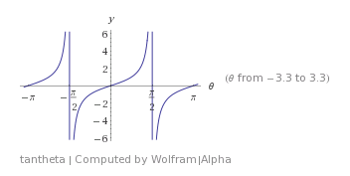
Numerator = 0 → t=0 or (t^6-21t^4+35t^2-7) = 0
Tan7θ = 0 → → θ=+-1pi/7, +-2pi/7, +-3pi/7
X=t^2 → x^3-21x^2+35x-7 = 0 → product of sums = -(-7)/(1) = 7 → the value is 7^0.5

Slide 5
NOTHING HERE
Input this into your calculator then you will get 5!

Slide 6
Well…
Similarly, Lets start with tan(14θ)=0
Tan14θ = 0 = sin14θ / cos14θ → sin14θ = 0
Sin14θ =
Divide by cos^14(θ) → 14tan^13(θ)-364tan^11(θ)
So we have: t(14t^12 – 364t^10 + …) = 0 where t=tan(θ)
14t^12 – 364t^10 + … = 0 (12 solutions here!)

Slide 7
14t^12 – 364t^10 + … = 0 (12 solutions here!)
We got 12 distinct solution if we take
Θ with N = 1, 2, 3, 4, 5, 6,
8,9,10,11,12,13
sin14θ = 0 →
Like in (i), take X=t^2 → then the solutions are
t^2(1pi/14, 2pi/14, 3pi/14, 4pi/14, 5pi/14, 6pi/14)
14t^12 – 364t^10 + … = 0 →
Sum of roots (using Vieta's formulas) = -(-364/14)= 26
T^2(2pi/14 + 4pi/14 + 6pi/14) = -(-21/1) = 21
From previous part→ (t^6-21t^4+35t^2-7) →
The Answer (N=1,3,5) = (N=1,2,3,4,5,6) – (N=2,4,6) = 26 – 21 = 5

